Slide 1

V1s
Icon reborn with improved response and agility
Clearer display with 1280×720 resolution
Android 6.0 - Smarter, safer.
Proprietary SUNMI algorithm that reads mobile-generated payment codes in 0.1 seconds.
Compatible with NFC modules and multi-function scanning platforms for improved versatility

Slide 2
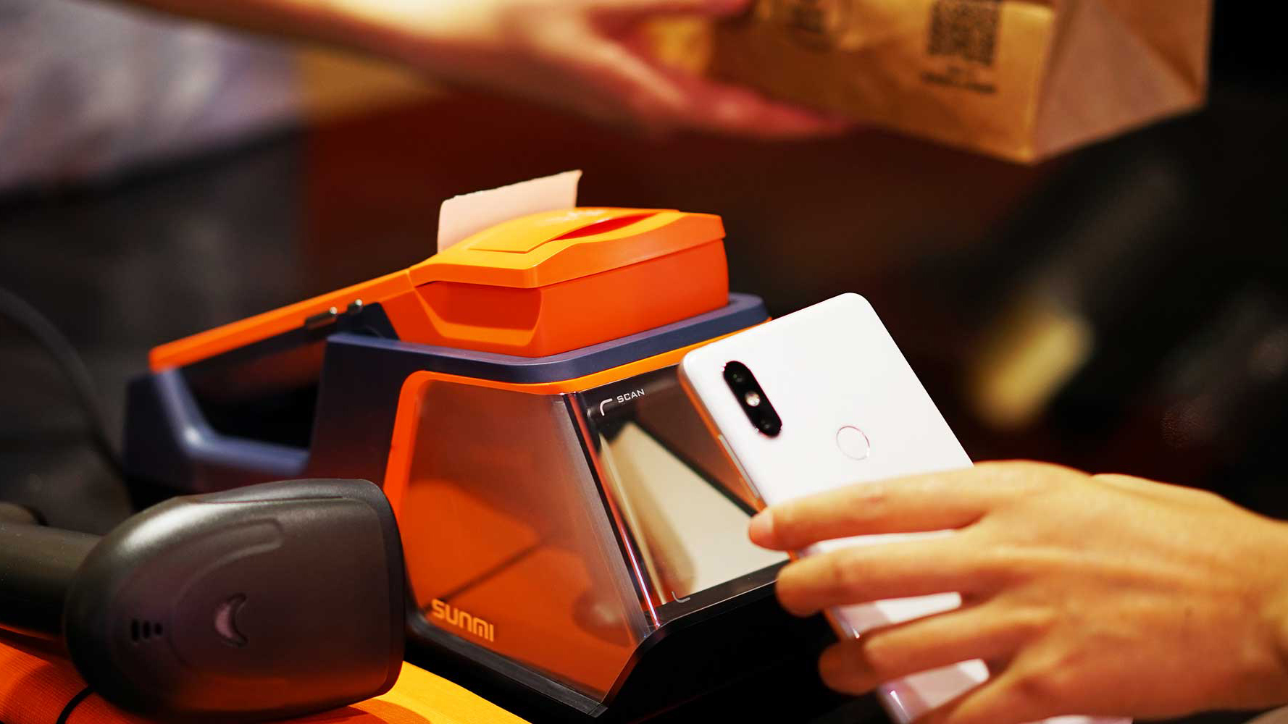
It can be paired with
a physical scanning platform
for handsfree operation
It’s time for an upgrade to a lightweight fixed POS system
that reads mobile-generated payment codes in 0.1 seconds

Slide 3
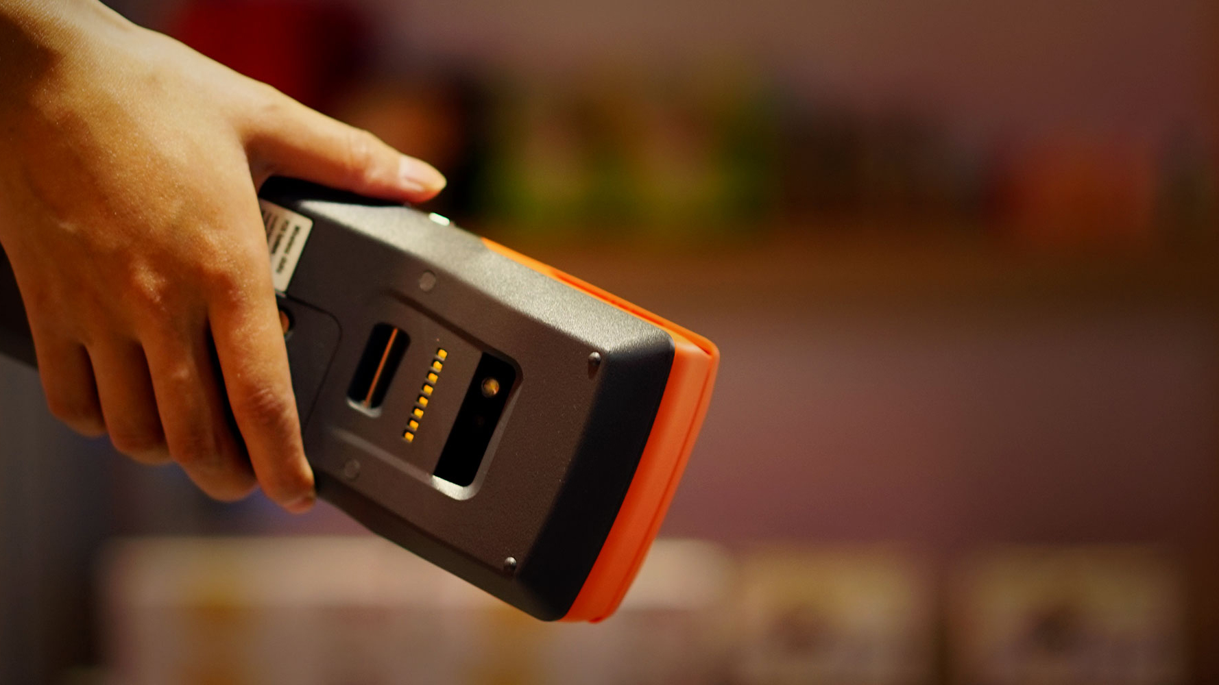
Can be used outdoor for generating
and displaying order numbers
ordering, payment and billing purposes
Its 5200mAh battery allows usage for
more than 1 full working day
or a standby time of up to 30 days

Slide 4
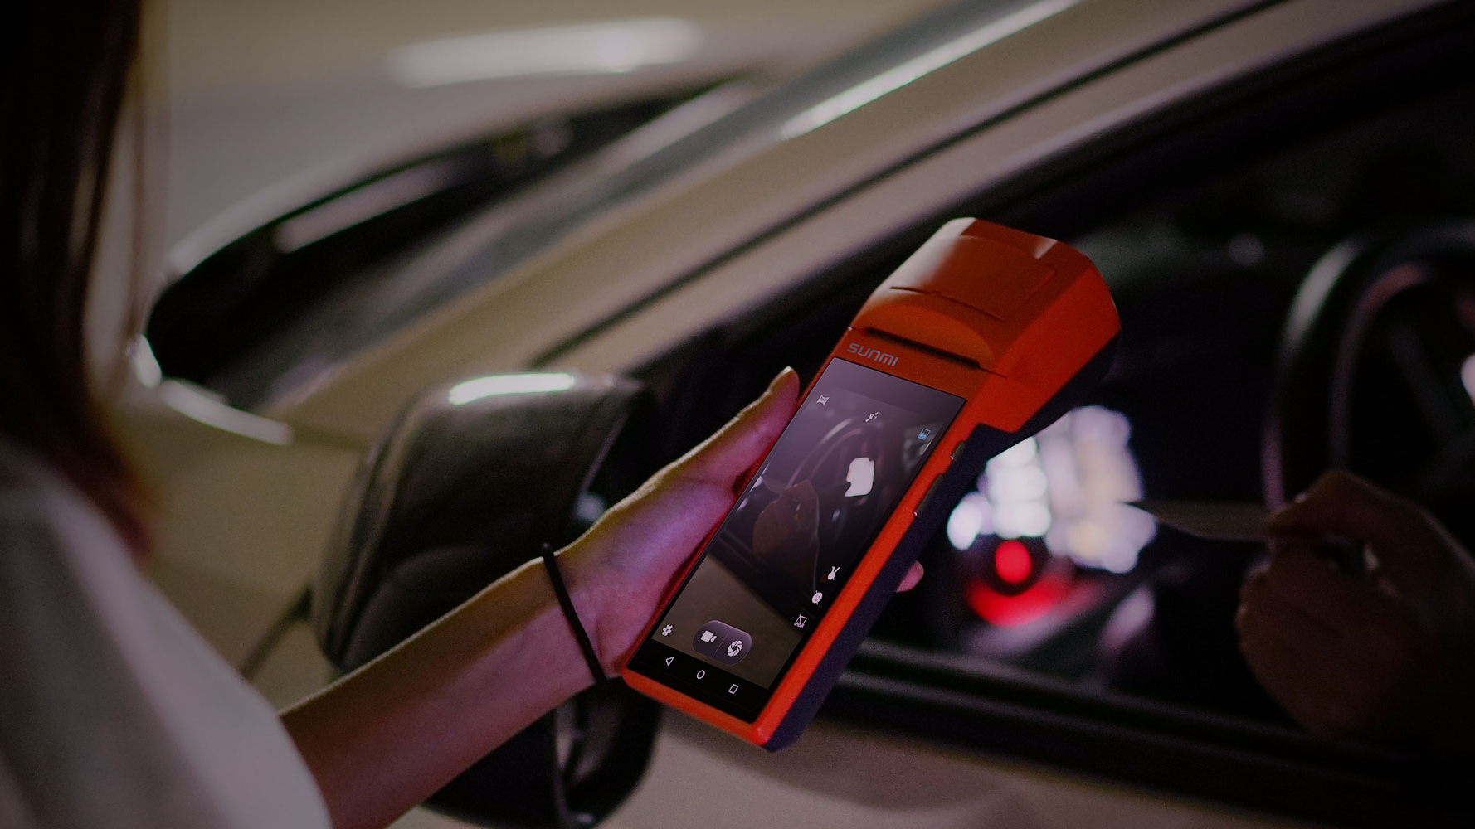
Comes with autofocus and
flash for picture-taking, day and night
It’s 5-megapixel camera comes with autofocus
and flash for picture-taking, day and night.
There’s also a built-in strap for easier handling and increased productivity

Slide 5


The latest SUNMI Os is safer
smoother and more stable
Industry-leading specification ensures
every terminal has the latest software installed
This prevents the leak and theft
of important information and messages
Improved software consistency
to avoid lagging at peak periods.
Allows oversea users to install tax module
Get up-to-date
information on devices’ physical location
for easier management.

Slide 6

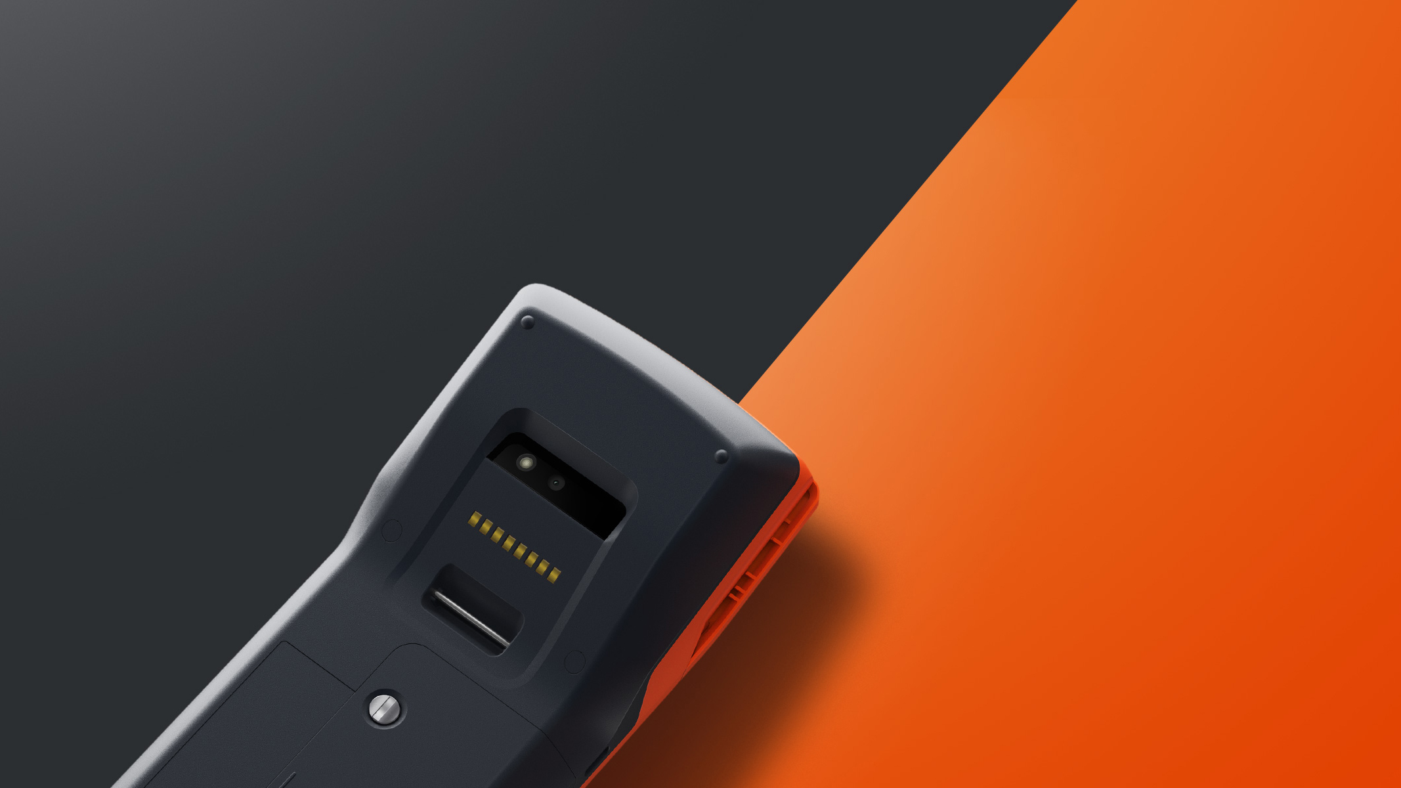
Latest SUNMI scanning algorithm that reads mobile-generated payment
codes in 0.1 seconds, reducing customers’ waiting time significantly
*Recommend to use with SUNMI scanning APK
With 5 megapixels and a built-in flash
users may take picture during day or night
to record important events

Slide 7
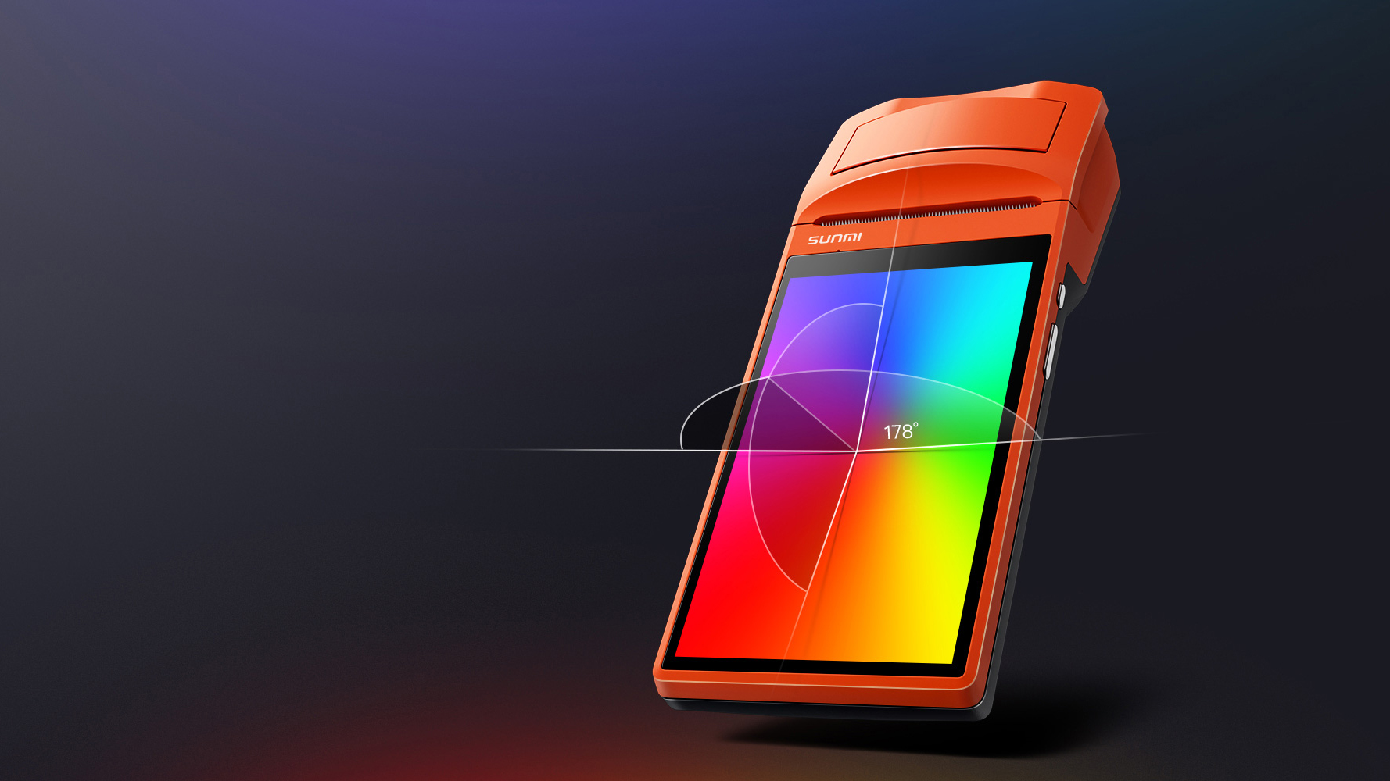
5.5''IPS screen
with 178° viewing angle
1280×720 resolution.
Users can be assured of a crystal-clear view

Slide 8
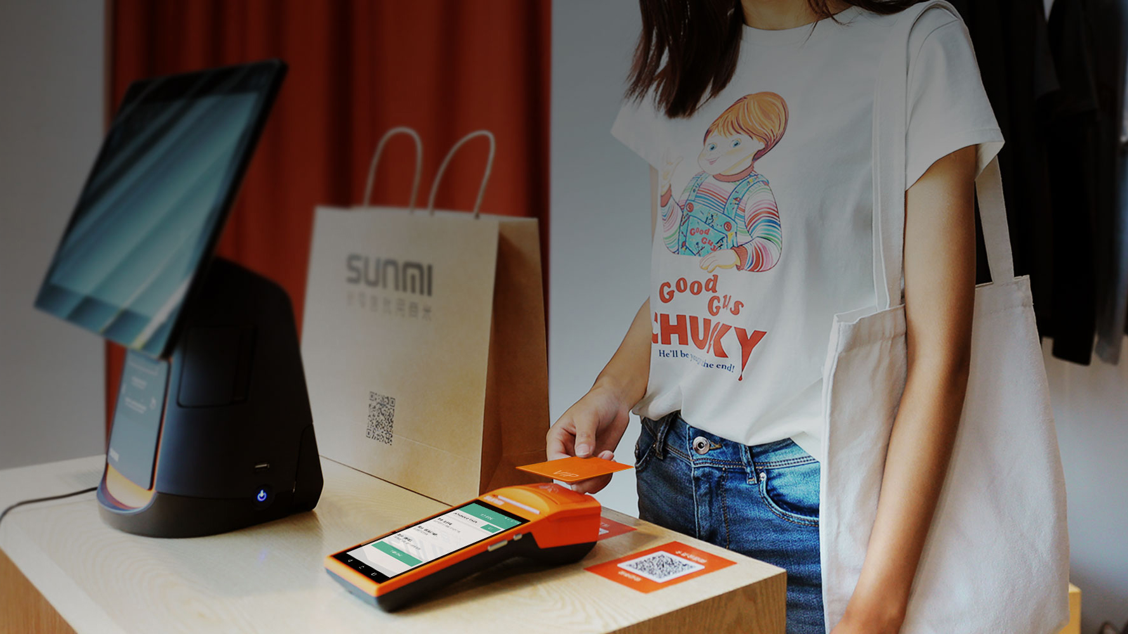
NFC module
for increased versatility
Supports loyalty card swiping function
including points tabulation and other services
for increased customer loyalty

Slide 9
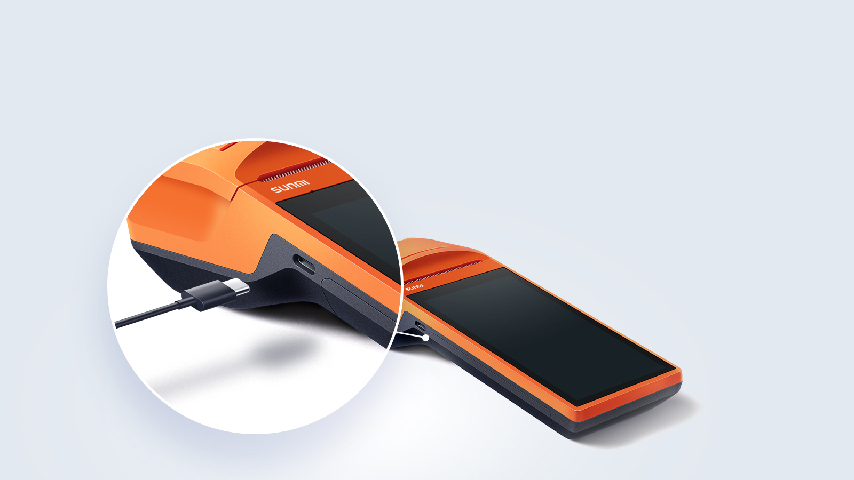
Type-c USB port for high-speed transfe
Double sided for easy use
Supports OTG for mobile barcode scanner,
adapters and USB drive,
increasing versatility for various needs

Slide 10
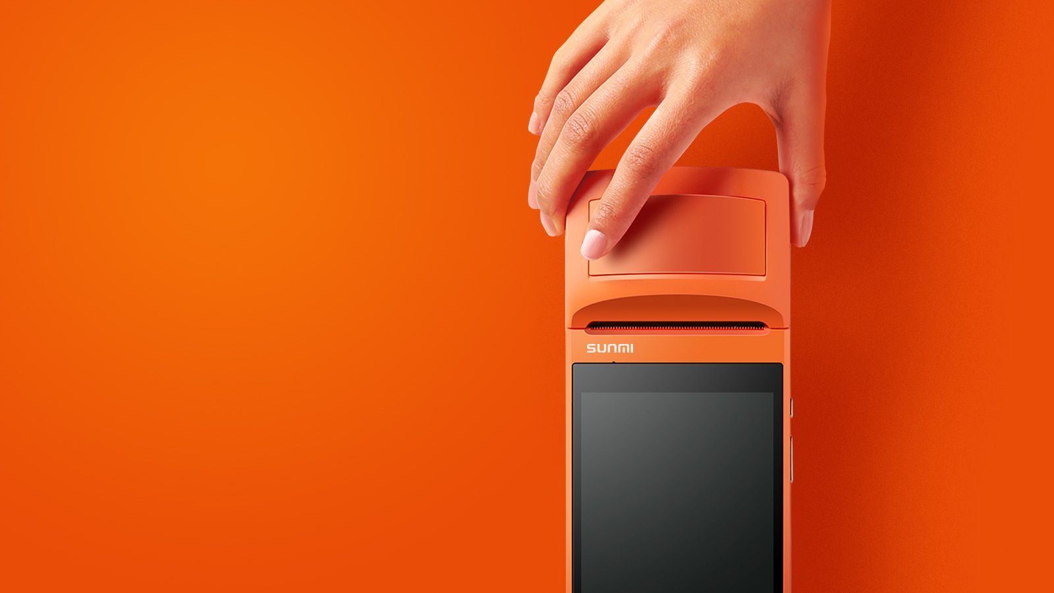
Increased build quality
comfortable one-handed operation
Ergonomically designed curved shell
to facilitate single handed operation
Iconic SUNMI orange colour sheds the drab industrial feel for a trendy look.

Slide 11
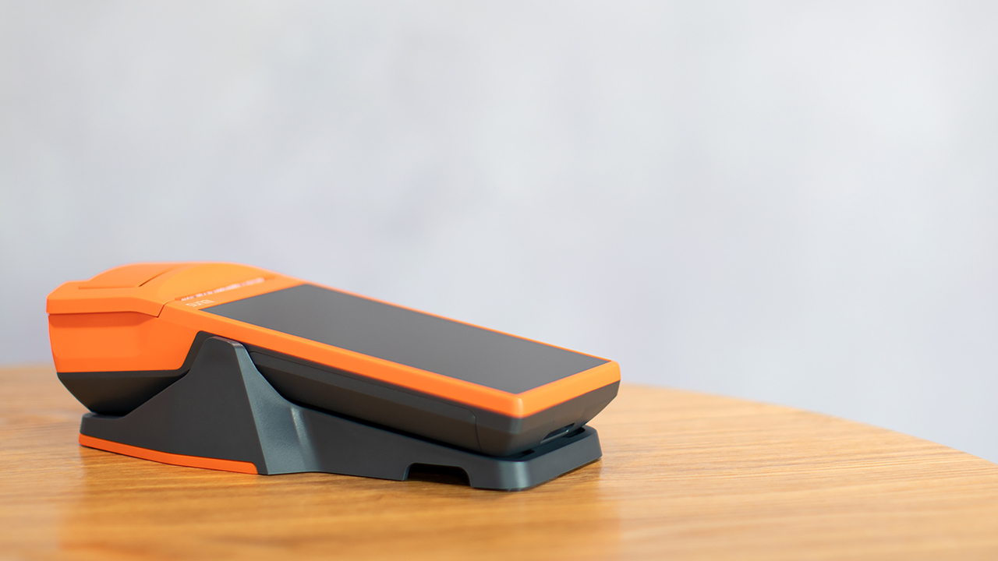


Extended base
Provides charging function for V1s
Expandable I/O interface
Supports OTG
*Provides 2 types of interface specification, single/dual-USB ports
OTG interface
Scanner

Slide 12
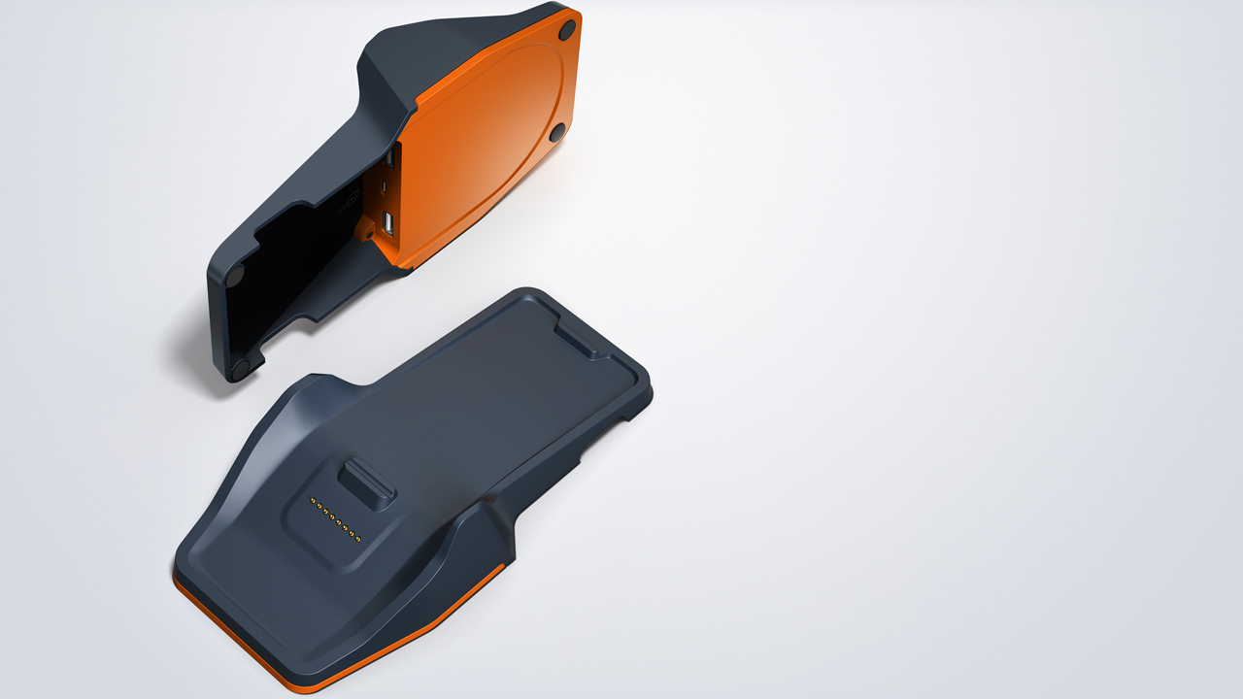

Slide 13

Hands Free Scanner
2018 Red Dot Award winner
The perfect countertop partner for V1s
with features of easy QR code scanning during power charging session
freed up your hands and keep your V1s running all day

Slide 14
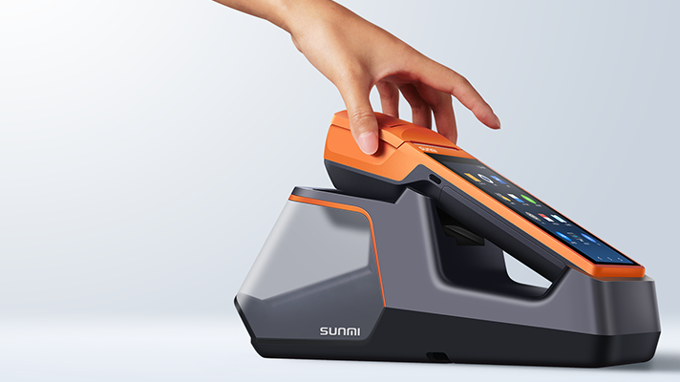

Slide 15

Mobile Strap
Easy to use and install
a safety strap for preventing your V1s dropping off from your hand.

Slide 16
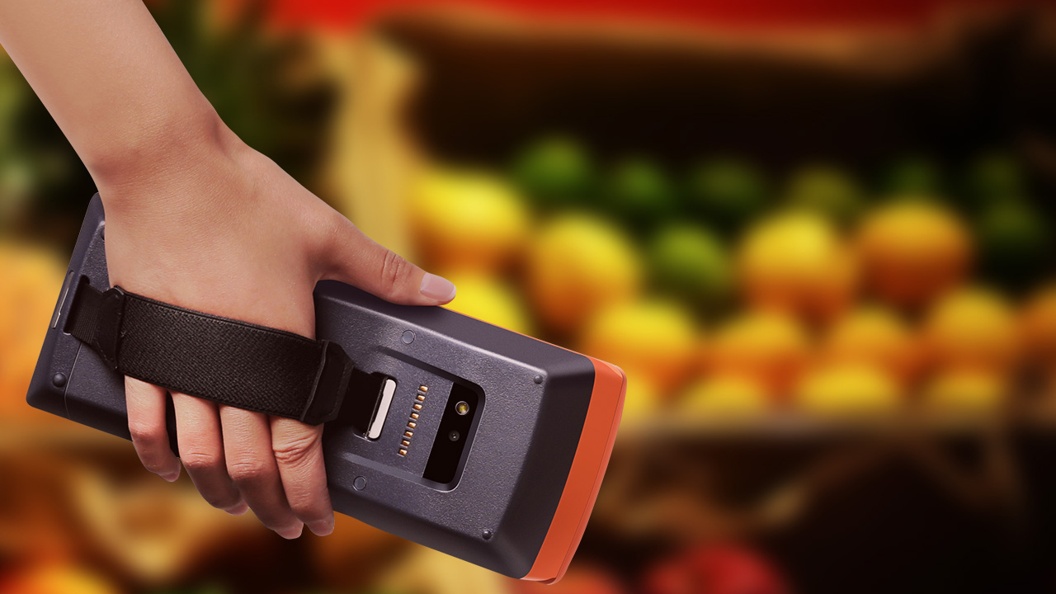

Slide 17
